Slide 1
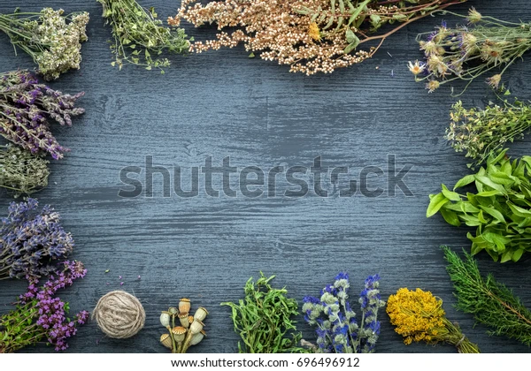
Evaluation of crude drugs
By
Dr. Zainab tuama
Stage 2

Slide 2
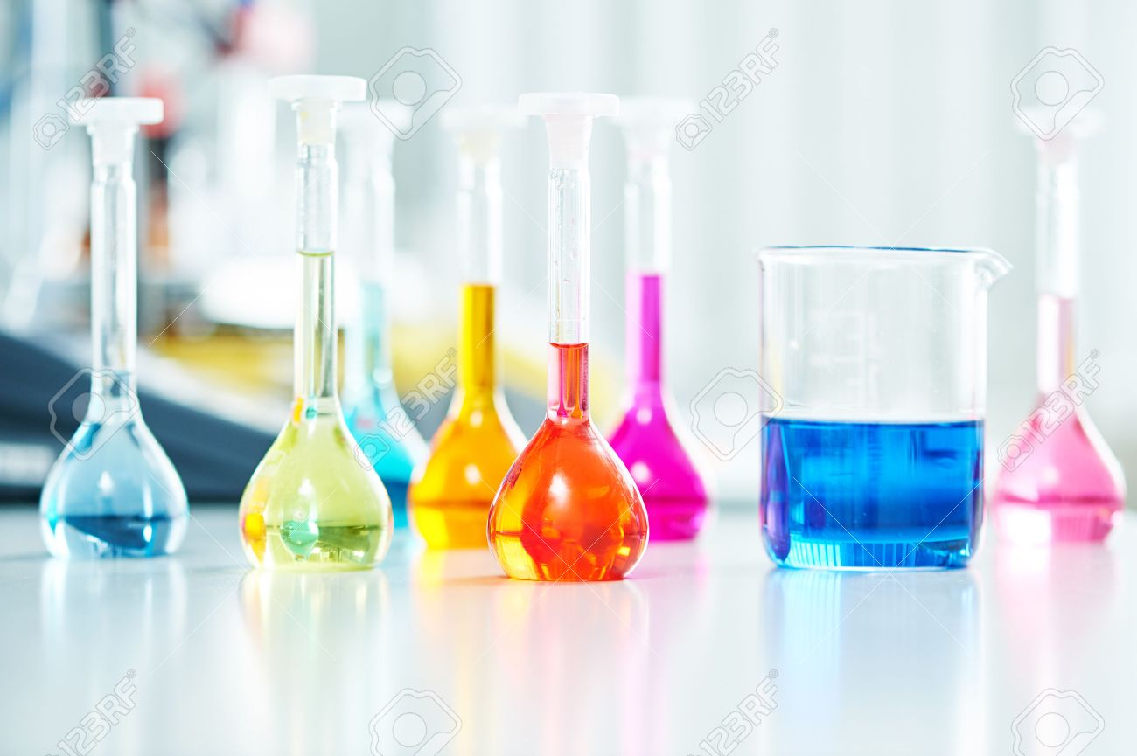
Adulteration is a practice of replacing original crude drug partially or whole with other similar looking substances. The substances, which is mixed, is either free from or inferior in chemical and therapeutic properties. The substance which is added with the original drug is called adulterants.
Adulterants: are either of substandard verities of the original crude drug or inferior drug or artificially prepared or other substance which are present in the original drug which decrease its quality. So, understanding of all the methods of adulteration and its evaluation technique is necessary to rectify this illegal act and maximizing consumers safety.

Slide 3
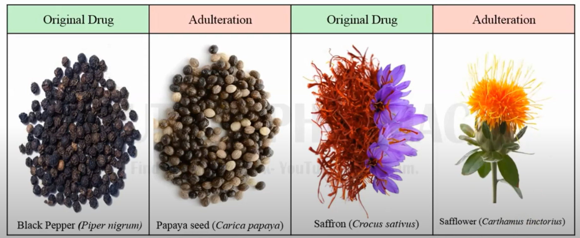
Types of adulteration
1. Adulteration by superficially similar looking : Substitution with superficially similar inferior drugs: Substitution of the original drug by superficially similar cheaper natural substances. These substances which is used for adulteration is very much similar in appearance to the original drug but not having any relation to original drug and may or may not have any chemical or therapeutic value.

Slide 4
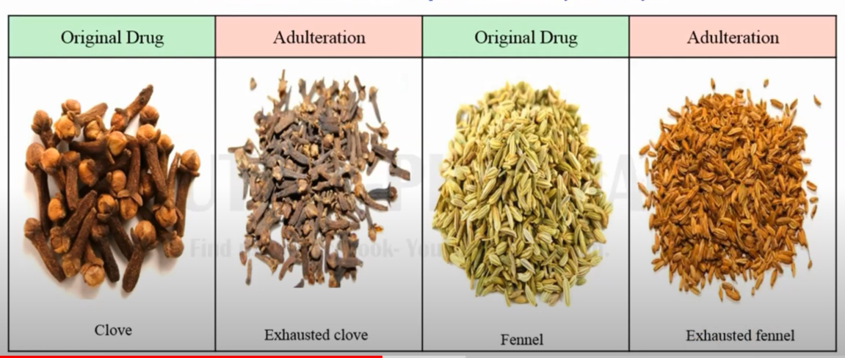
2. Substitution by exhausted drug: same drug is used again after removing / extraction out the medicinally active constituents most common in case of costly drug such as case volatile oil containing drug ( clove and fennal)

Slide 5
Evaluation Methods of Adulteration
Evaluation means determination of identify, quality and purity of any drug. There are different evolution methods available by which we can detect any type of adulteration in the original drug
Evaluation
Identity
Purity
Quality
Identity means to determine the originality or exact biological source of drug. Whether the drug we are using are from the same biological source or from different source
Purity evaluation means to check the presence of foreign material, either organic or inorganic which may be present in the drug accidently or intentionally added to the drug to earn more money
Quality means to determine the concentration of therapeutically active constituent present in the drug and comparison with the standard value so that the drug produce desirable therapeutic effect

Slide 6
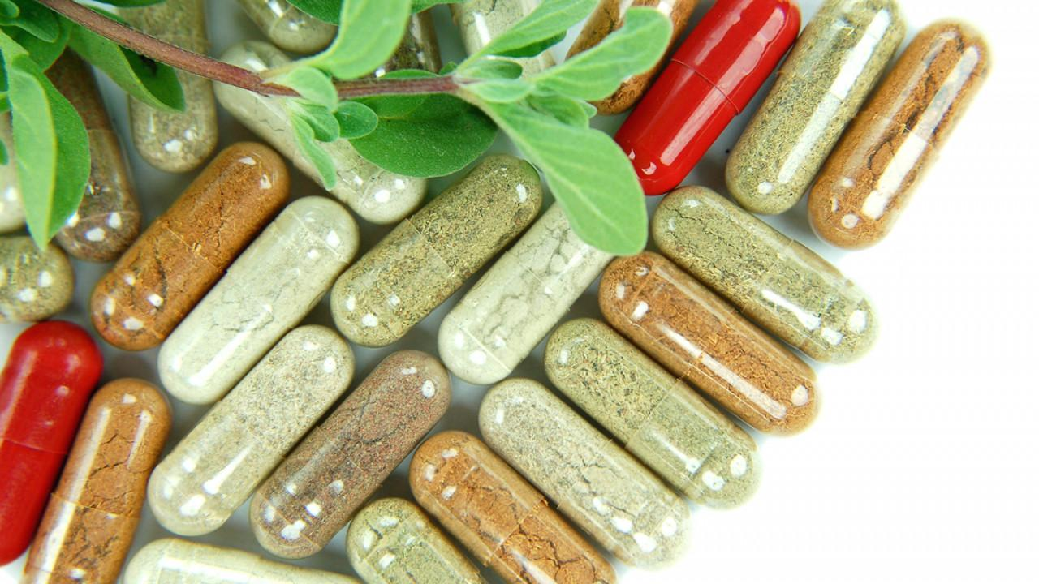
Methods of Drug Evaluation: The evaluation of a drug is done by studying its various properties. The various properties are
1)Organoleptic Evaluation
2)Microscopical Evaluation
3) Chemical Evaluation
4)Physical Evaluation
5)Biological Evaluation
1- Organoleptic (Morphological) evaluation- Organoleptic evaluation means the study of drugs using organs of senses. It refers to the methods of analysis like colour, odour, taste, size, shape and special features, such as, texture, etc. Obviously, the initial sight of the plant or extract is so specific that it tends to identify itself. If this is not enough, perhaps the plant or extract has a characteristic odour or taste.

Slide 7
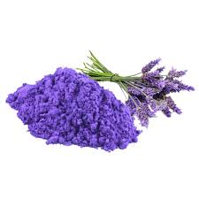
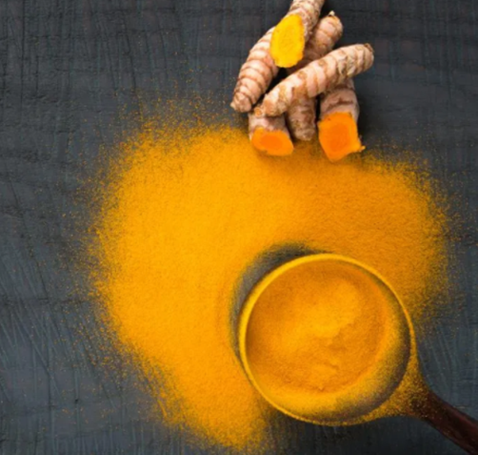
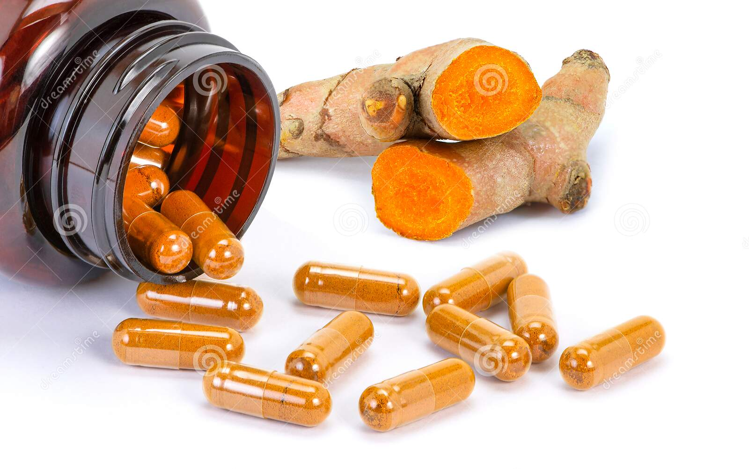
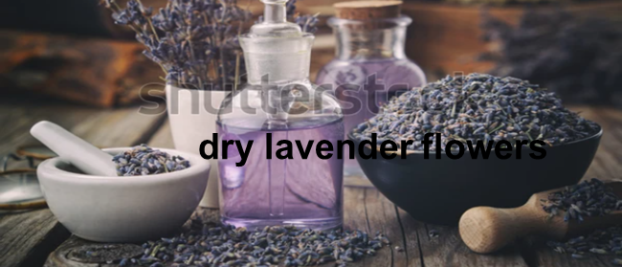
Organoleptic evaluation-
colour
Curcuma longa (turmeric)
Lavandula angustifolia

Slide 8
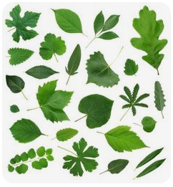
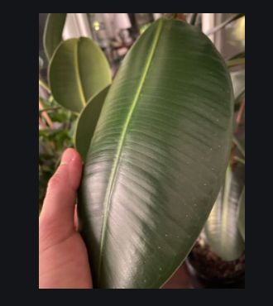
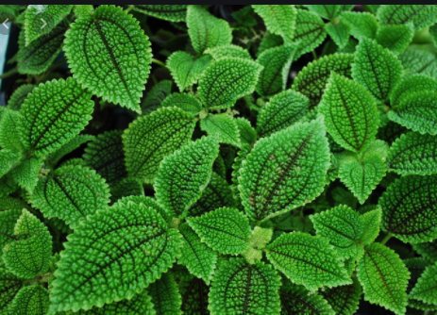
shape
Texture
Smooth or rough

Slide 9
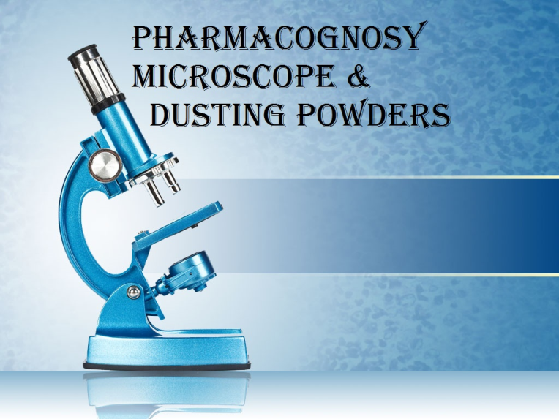
Microscopical Evaluation
This method allows more detailed examination of a drug and it can be used to identify the organised drugs by their known histological characters. It is mostly used for qualitative evaluation of organised crude drugs in entire and powdered forms. Every plant possesses a characteristic tissue feature. Microscope can be used to confirm the structural details of the drugs from plant origin
Study of microscopical characters of the crude drug like:-
1. cell contents like starch,
2. calcium oxalate,
3. special structures like stomata
4. Vein-islet number

Slide 10
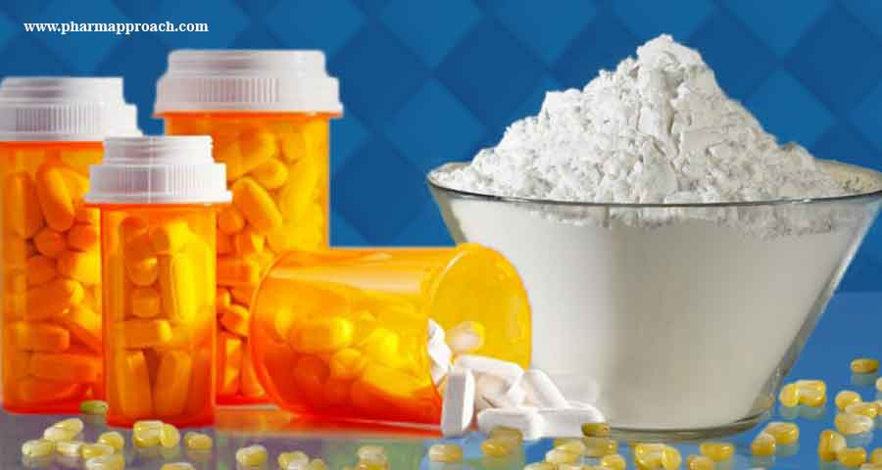
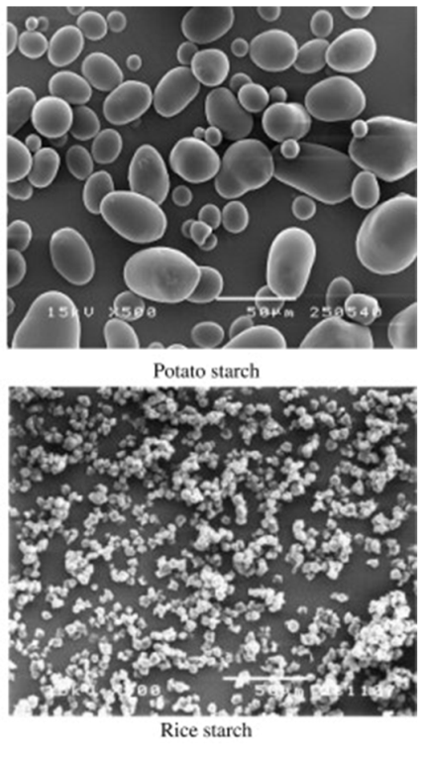
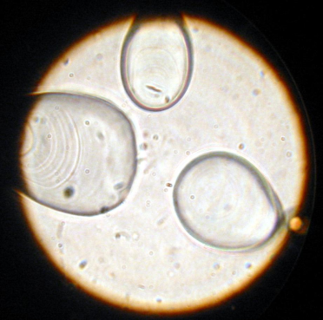
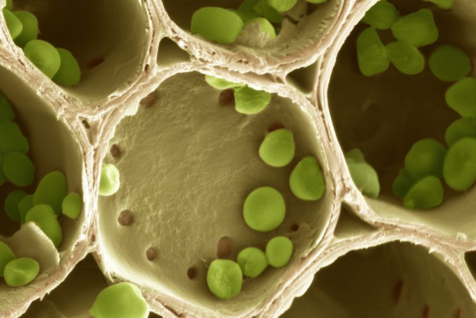
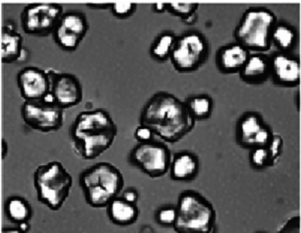
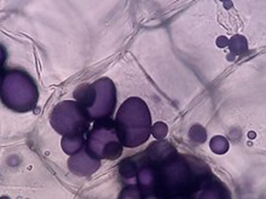
Starch
Starch have the same color but under the microscope we can differentiate between the different types of starch grains.
Corn starch

Slide 11
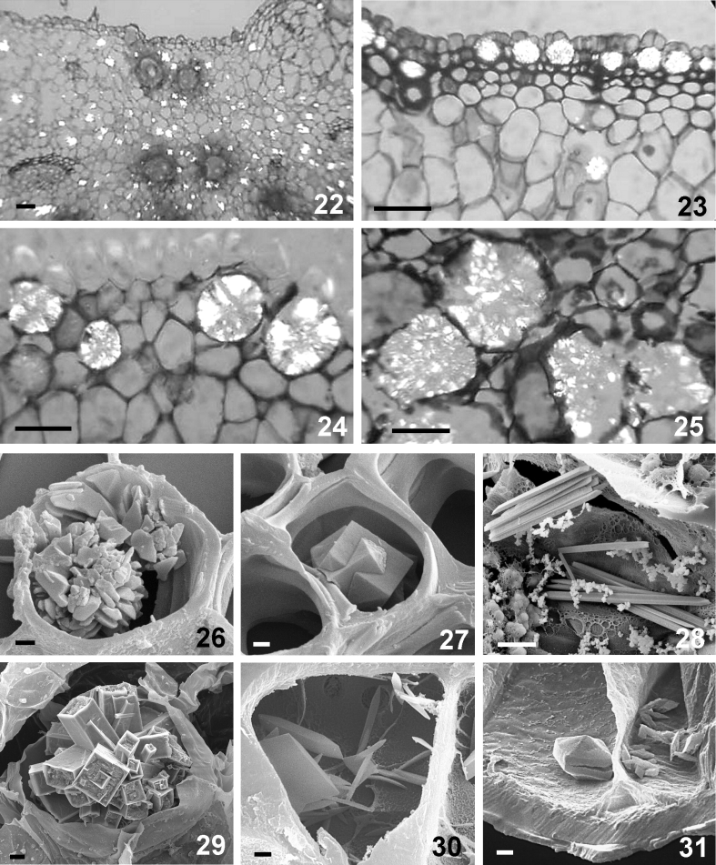
2. calcium oxalate:- calcium oxalate crystals of different types are found in different organs of the plant. They may be present in almost all parts of the plant are useful in correct identification of crude drugs. Help in detection of adulterants. Calcium oxalate precipitates in cell in different shapes & sizes:

Slide 12
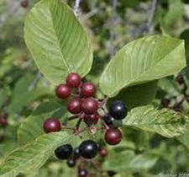
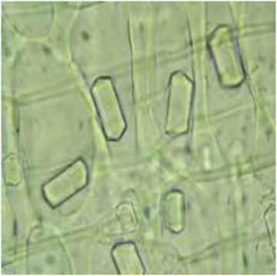
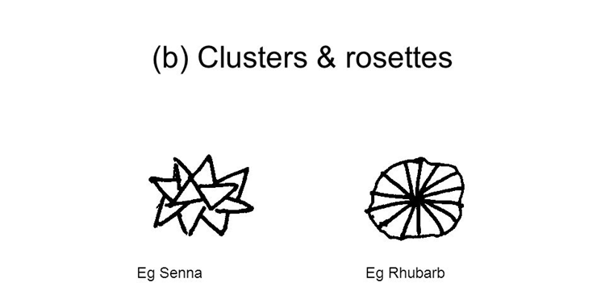
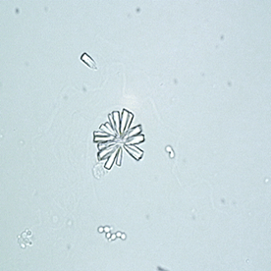
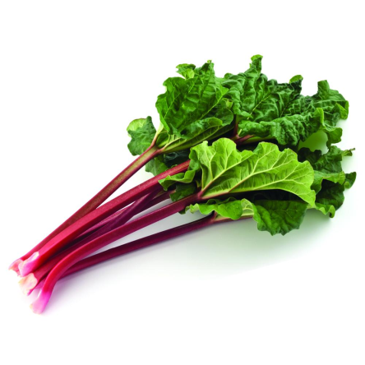
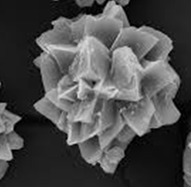
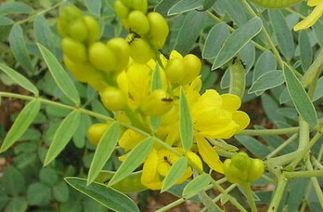
.
1. Prisms: e.g. Cascara القشرة المقدسة
2. Clusters (rosettes) e.g. Rhubarb
3. Cluster: e.g. Senna

Slide 13
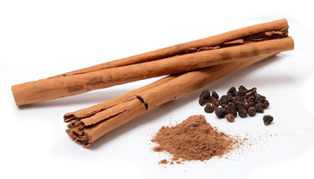
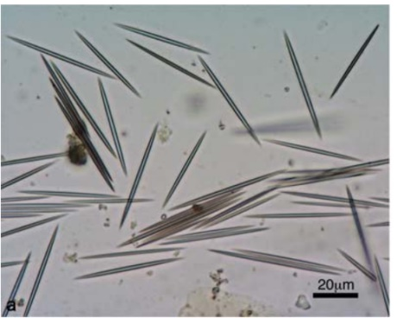
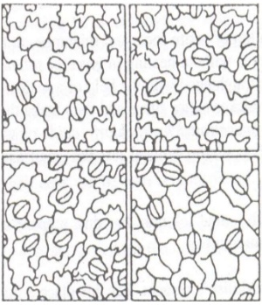
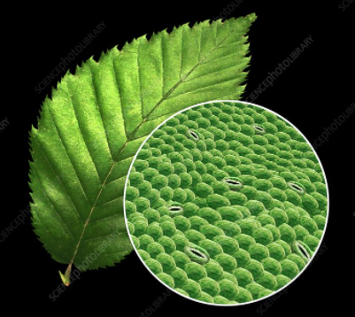
4. elongated needle crystals = (raphides)
In Cinnamon
3. Stomata:- Are tiny openings or pores in plant tissue that allow for gas exchange. Stomata are typically found in plant leaves but can also be found in some stems.

Slide 14
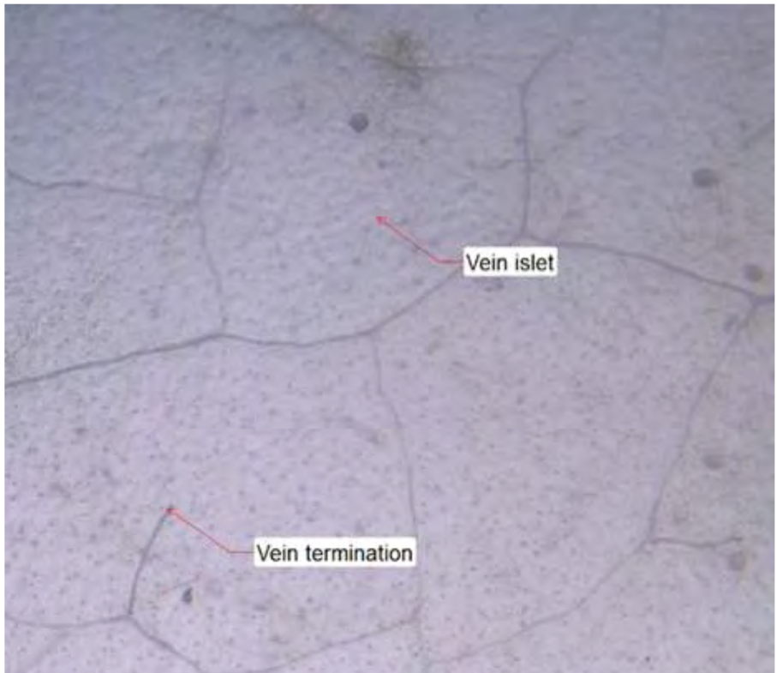
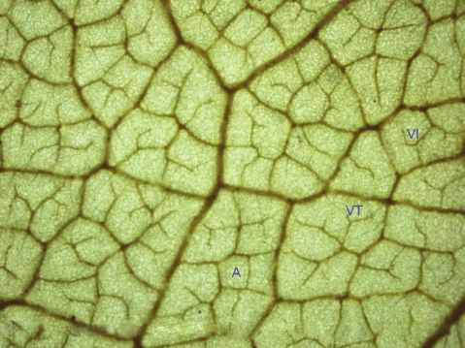
4. Vein-islet is the small area of green tissue surrounded by the vein-lets. The vein-islet number is the average number of vein-islets per square millimeter of a leaf surface. It is determined by counting the number of vein-islets in an area of 4 sq. mm

Slide 15
Chemical evaluation- The chemical evaluation includes qualitative chemical tests, quantitative chemical tests, chemical assays and instrumental analysis. The isolation, purification and identification of active constituents are chemical methods of evaluation. Qualitative chemical tests include identification tests for various phytoconstituents like alkaloids, glycosides, tannins, etc
By using chemical tests to evaluate crude drug (to determine the active constituents of the drug) by using chemical reagents in a colored reaction, such as:
1) Drug contain Orange to red
alkaloid Dragendroff's color
2) Drug contain KOH sol. 5% Red color
glycoside
3) Drug contain FeCl₃ sol. Green to
Tannins brown color

Slide 16
Physical evaluation- Physical standards are to be determined for the drugs, wherever possible. These are rarely constant for crude drugs, but may help in evaluation, specifically with reference to
moisture content,
specific gravity,
density,
optical rotation,
refractive index,
melting point,
viscosity, and solubility in different solvents.
1) Moisture content- The moisture content of a drug will be responsible for decomposition of crude drugs either producing chemical change or microbial growth. So, the moisture content of a drug should be determined and controlled.

Slide 17
Eg. The moisture content of digitalis than 5%W/W, respectively.
2) solubility- Drug specific behaviour towards solvents are taken into consideration.
3) Refractive index- It is defined as the property of a material that changes the speed of light, computed as the ratio of the speed of light in a vacuum to the speed of light through the material.
4) Melting point
5) Viscosity

